Slide 1


Contact
Amrit
Sparsh
Healthcare Management System for Students.
Submitted By -
Ajay Kumar Sharma
Amit Kumar Dhara

Slide 2



Problems Faced
by Students
No centralized healthcare system.
No easy access to health records.
Manual leave permission process.
No reminders for checkups or medicines.
No quick emergency response system.
Delayed and manual appointment bookings.

Slide 3
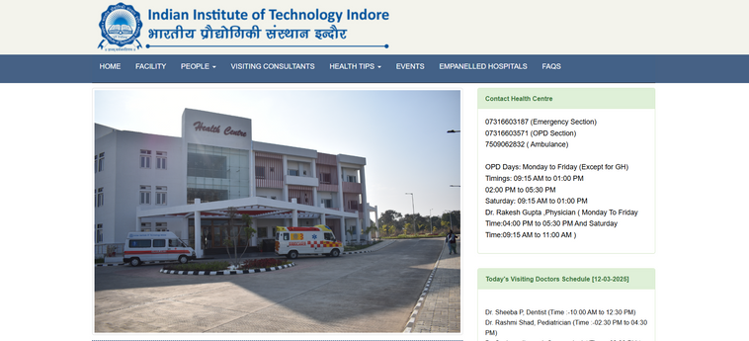
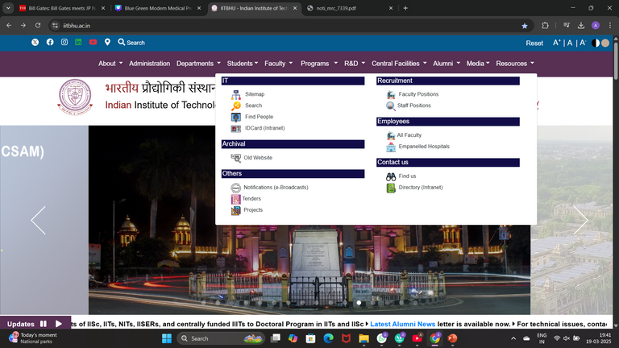
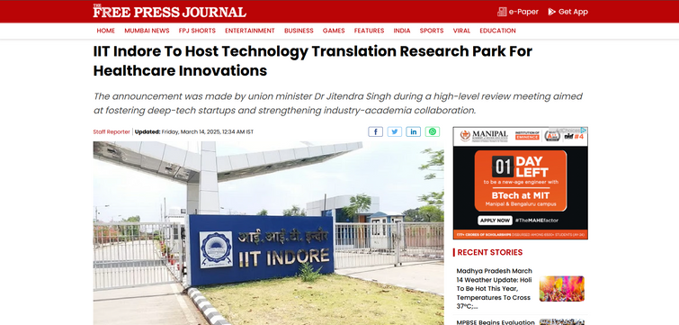
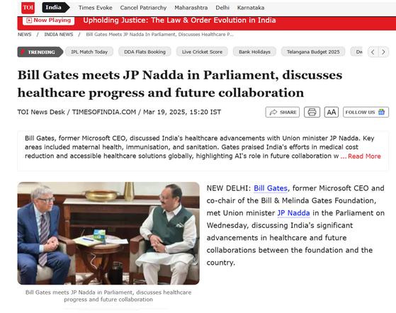
Understanding the Concept
The Current Healthcare Scenario at IIT’s
Limited Student Healthcare
IIT Indore provides basic OPD and emergency services.
No digital system exists for managing student
health records or appointments.
IIT Indore : Future Healthcare Hub
IIT Indore is setting up a healthcare-focused Technology Park (TTRP). It aims to lead healthcare innovations and deep-tech startups.

Slide 4
About
Amrit Sparsh
A digital healthcare platform designed to streamline and manage the health services of students in IITs , NITs , IIITs
and other universities.
Our Vision
Leading student healthcare with seamless digital services.
It offers easy access to medical records, automated certificates, appointment booking, health alerts, and emergency SOS—all in one place.
Our Mission
Providing quality , friendly and accessible care.
It saves time, removes paperwork, and ensures quick care. Students stay informed, connected, and in control of their health—anytime, anywhere.

Slide 5



Types of Medical
Services Provided
Simplifying Student Healthcare with Smart , Accessible Services . One Platform for All Your Health Needs — Anytime , Anywhere.
One Tap , All Reports And
Prescriptions
Personalised Health
Board
Consult Doctor Anywhere
Anytime

Slide 6
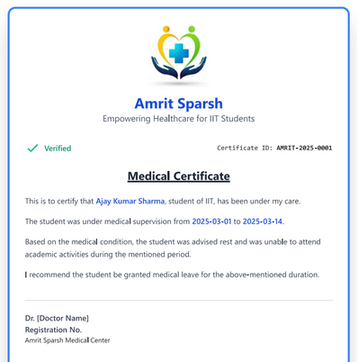
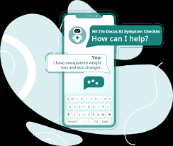

Types of Medical
Services Provided
Simplifying Student Healthcare with Smart , Accessible Services . One Platform for All Your Health Needs — Anytime , Anywhere.
AI Powered Symptoms
Checker
Smart Health Reminders
and Period Support
Automated Documentation Generation

Slide 7



Emergency Access &
Medical History Sharing
Instant access to life-saving medical information in emergencies, while ensuring privacy and security.
Secure Login Access
Emergency Contact Alerts
Quick Medical History Access
Privacy & Data Security

Slide 8




Recognition of Amrit Sparsh
at Leading Institutions & Competitions
MP Govt. & RGPV Combined Incubation Centre
IIT Indore
IIT Varanasi (BHU)
Vikrant Group of Institutions
Finalist in Healthcare Management System competition.
Finalist in Healthcare & AI: Hand in Hand challenge.
Selected among Top 15 Startup Projects from all over M.P.
Finalist in Udaan 3.0 Startup Competition.

Slide 9

Meet Our Team
The Minds Behind Amrit Sparsh
Ajay Kumar Sharma
Amit Kumar Dhara
Ms. Shruti Sharma
Ashok Kumar Sharma
Mr. Sanmati Jain
Team Leader
Pursuing B.Tech (CSE)
Completed Internships
with Microsoft (AI)
and
IBM (Cybersecurity).
Mentor
Pursuing M.Tech (CSE)
GATE Qualified , RGPV Top Scorer , Student of the Year RGPV 2022 ,
Expert in Algorithms & AI
Medical Advisor
Senior consultant in Hospital Management Systems. Implemented over 17 hospital across India.
Team Co-Leader
Pursuing B.Tech (CSE)
Completed Android Development internship at Codesoft.
Mentor
HOD ( CSE ) VGI
2x GATE Qualified , Developed IoT Device for Diabetes Management.

Slide 10

Innovative Tech Stack
for Seamless Healthcare
Frontend : HTML , CSS , JavaScript
Backend : Python (Flask Framework)
Database : MySQL
Cloud Services : AWS
Android Development : In Progress
Testing Phase : Will be Conducted at Vikrant Group of Institutions, Nursing College

Slide 11
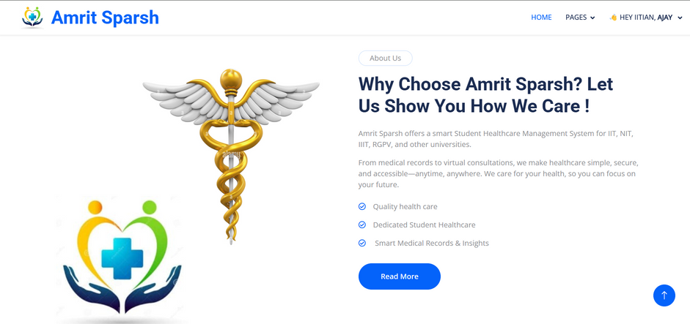
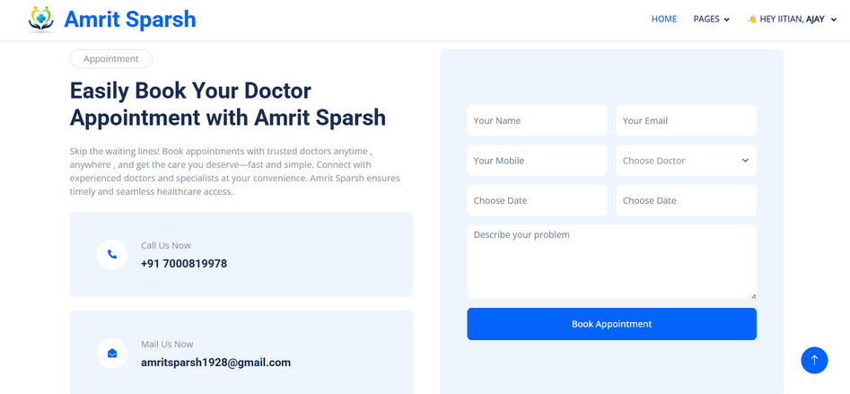

More Complete
Information in Prototype
+91 - 7000819978
+91 - 8878230125
amritsparsh1928@gmail.com

Slide 12
Thank
You
Team Amrit Sparsh

